Slide 1
Ethics & Sustainability in Case Competitions
JDC West case competition

Slide 2
Why are you here?
Notes:
Same applies to cases!

Slide 3
“Doing well on an exam isn’t about figuring out the right answer. It’s about figuring out what the exam creator thinks the right answer is.” –James Hardisty
Notes:
Same applies to cases!
This isn’t a lecture about what’s ethical, or what’s sustainable, or what’s good for business. This lecture is about how to win cases.

Slide 4
Agenda
The case for E&S in cases
Stakeholder framework
Materiality
SDGs
Notes:
ASK: Questions from Asynchronous lecture or prep?

Slide 5
The case for E&S in cases
Some alternatives in cases are “no gos” (aka, “zero tolerance”)
(Sometimes) reduced operational costs from E&S
Long-term financial benefits from E&S
Younger consumers respond to E&S

Slide 6
Some caveats for E&S in cases
E&S benefits are long term
Don’t trust what people say – look at behaviour
E&S can be polarizing – important to accurately judge the judges, or go “big tent”
Product must be both excellent and E&S (a sustainable product that “doesn’t work” will fail)

Slide 7
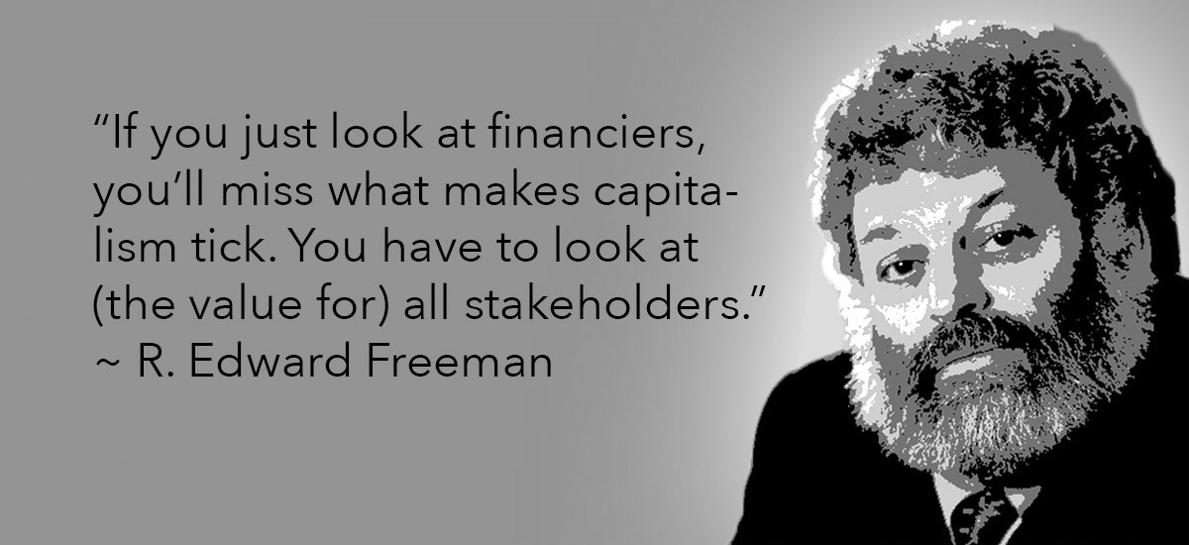
Stakeholder Theory
, 2009
From “Managing for Stakeholders and the Purpose of Business”, Freeman & Parmar, 2018
Image source: socialbusinessstrategy.com
Notes:
Video hyperlinked from image: https://youtu.be/bIRUaLcvPe8
Image source: socialbusinessstrategy.com

Slide 8
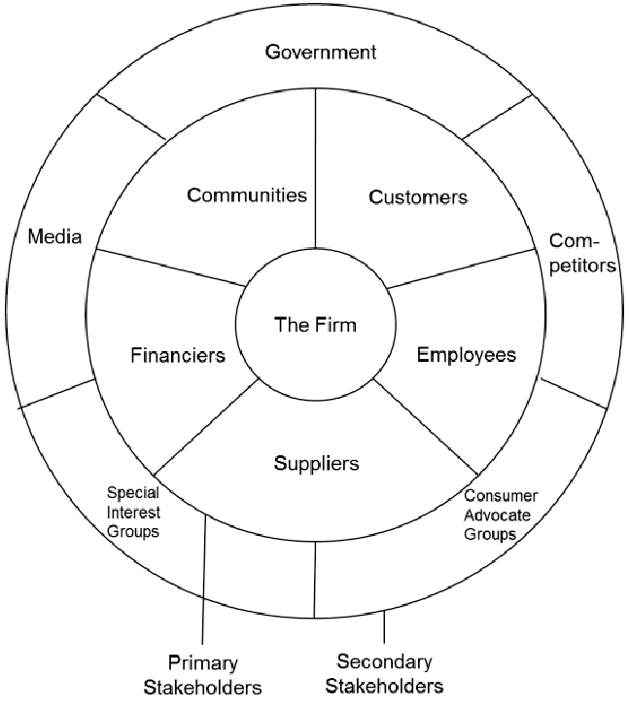
Key Points of Stakeholder Theory
The Environment
Stakeholders are not faceless
“Capitalism is a system of social cooperation and collaboration”, not just of competition
See stakeholder interests as inherently tied together, not as trade-offs
In the long run, serving all stakeholders is key to profitability
From “Managing for Stakeholders and the Purpose of Business”, Freeman & Parmar, 2018
Notes:
Before clicking the final bullet, ASK: What’s missing? Hopefully someone says (but even if they do not), “The environment is a stakeholder!”
This used to be a more academic theory, but now it is completely mainstream.
Image source: https://www.researchgate.net/figure/Stakeholders-Map-Source-Freeman-Harrison-Wicks-2008_fig1_319701620

Slide 9
BlackRock CEO’s Annual Letter
“A company cannot achieve long-term profits without embracing purpose and considering the needs of a broad range of stakeholders”
“Ultimately, purpose is the engine of long-term profitability”
“We believe that sustainable investing is the strongest foundation for client portfolios going forward”
Notes:
Again, connect to Larry Fink’s CEO Letter.

Slide 10
UN SDGs
What E&S issues do most people care about?
UN Sustainable Development Goals (SDGs) is a common reference
https://sdgs.un.org/goals
Notes:
Again, connect to Larry Fink’s CEO Letter.

Slide 11
Materiality
How do you decide which E&S issues to prioritize?
Financial materiality (accounting law): publicly traded companies must disclose information that could significantly affect the value of their shares (i.e. affect things like revenue, profit, assets, debt)
More generally: defining the social and environmental topics that matter most to your business and to your stakeholders
Notes:
Assigned reading: https://www.unilever.com/sustainable-living/our-approach-to-reporting/defining-our-material-issues/
Not assigned, but helpful as background for teaching:
https://assets.kpmg/content/dam/kpmg/pdf/2014/10/materiality-assessment.pdf
http://www.materialitytracker.net/standards/financial-thresholds/#:~:text=The%20materiality%20threshold%20is%20defined,%2D10%25%20requires%20judgment).
Background on financial materiality:
In for example the USA, Section 409 of the Sarbanes-Oxley Act of 2002 requires the disclosure of a material event in Form 8-K within four days. In Canada, the TSX Timely Disclosure Policy of 2004 requires listed companies to immediately disclose material information that could significantly affect the market price or value of their securities. It specifies that this includes information related to environmental and social issues.
In financial accounting and auditing, determining the threshold level of materiality requires that an appropriate base level and percentage be decided on. Traditionally the financial community refers to accounting variables such as net income (before taxes) or earnings, revenue, total assets and total debt/equity as benchmarks. The materiality threshold is defined as a percentage of that base. The most commonly used base in auditing is net income (earnings / profits). Most commonly percentages are in the range of 5 – 10 percent (for example an amount <5% = immaterial, > 10% material and 5-10% requires judgment).
Expansion of “Materiality” beyond just financial to include stakeholders (from KPMG report):
Materiality is the principle of defining the social and environmental topics that matter most to your business and your stakeholders. Some 80 percent of the world’s largest 250 companies already identify material sustainability issues in their reporting.1 Yet the process of identifying material issues is a challenge that clients of KPMG member firms are increasingly seeking our professional guidance on. This is primarily due to the growing focus on materiality in reporting frameworks and accounting standards, such as the Global Reporting Initiative’s (GRI) G4 guidelines, the International Integrated Reporting Framework and the Sustainability Accounting Standards Board (SASB) in the US. In addition, new regulation - such as the European Directive on non-financial reporting2- and increasing stock exchange requirements to report environmental, social and governance (ESG) risks3 are leading companies to consider what non-financial information matters and what they should report. As a result, many companies are looking to revise and update their materiality assessment processes. While many large companies understand the principles of materiality, some struggle to define and implement a robust process. This is reflected in the fact that of the 250 largest companies in the world (by revenue) that define material topics in their sustainability report, 41 percent do not explain the process used and less than half (45 percent) clearly explain how stakeholder input is used to identify material topics.4 Common challenges with the materiality process include: incorporating and prioritizing stakeholder views, involving senior management, and extending the materiality assessment beyond the company’s own operations, across the value chain.

Slide 12
Materiality Mapping Example: Unilever
Image source: pgmcapital.com, 2020
Notes:
Some Unilever brands: Dove, Lipton, Axe, Vaseline, Seventh Generation, Ben & Jerry’s, TAZO, Hellman’s, Lifebuoy, Marmite, Pears, Persil, Popsicle…
Image source: https://www.pgmcapital.com/highlights-of-the-unilever-group/

Slide 13
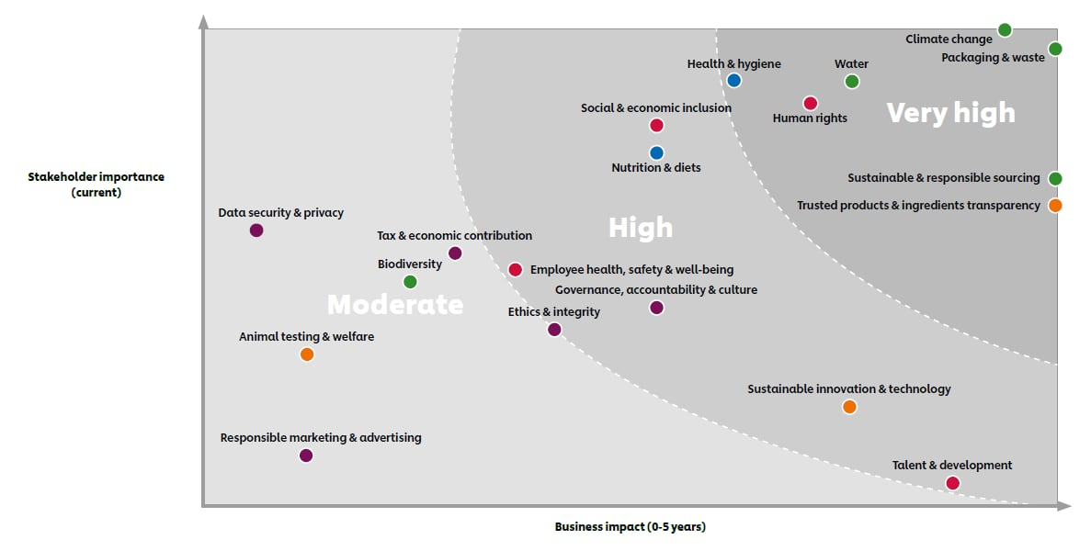
Materiality Mapping Example: Unilever
Image source: Unilever.com, 2020
Notes:
Firstly, it impacts our business significantly in terms of growth, cost or risk. And secondly, it is important to our stakeholders – such as investors, society (citizens, NGOs, governments), consumers, customers (retailers), suppliers and our employees – and they expect us to take action on the issue. In determining if an issue is material, we consider our impacts across the value chain.

Slide 14
Determining Materiality: Unilever
Does it impact the business in terms of growth, costs, risk, or trust?
Is it important to our stakeholders (consumers, customers, employees, governments, investors, NGOs, suppliers…), and an issue they expect us to act on?
Does it align with vision and purpose?
To what degree can we affect change?
Source: Unilever.com, 2020
Notes:
Image source: https://upload.wikimedia.org/wikipedia/en/thumb/e/e4/Unilever.svg/1200px-Unilever.svg.png

Slide 15
Breakout Discussion: Integrating sustainability concepts
Choose one of the businesses: Bottled beverage company (e.g. Coca-Cola); Fashion brand (e.g. Zara); or Airline (e.g. Air Canada).
Materiality: Identify what you think is a material issue on each of the social, environmental, and economic fronts of that business, and briefly explain why.
SDGs: Identify which of the SDGs these issues directly connect to (refer to https://sdgs.un.org/goals).

Slide 16
Debrief
Which business did you choose?
Which material issues did you identify, and why?
Which SDGs did you connect to?

Slide 17
Think about what you put out into the world; make it a better place.
Thank you!

